Slide 1
Association with Behavioral Data for the 3 Largest Cluster
Update – new behavioral visualization and significance tests with non-standardized values, also updated visualization

Slide 2
Settings
Skipping all the non-significant matrices as well as matrices that only have up to three randomly scattered signficant cells.

Slide 3
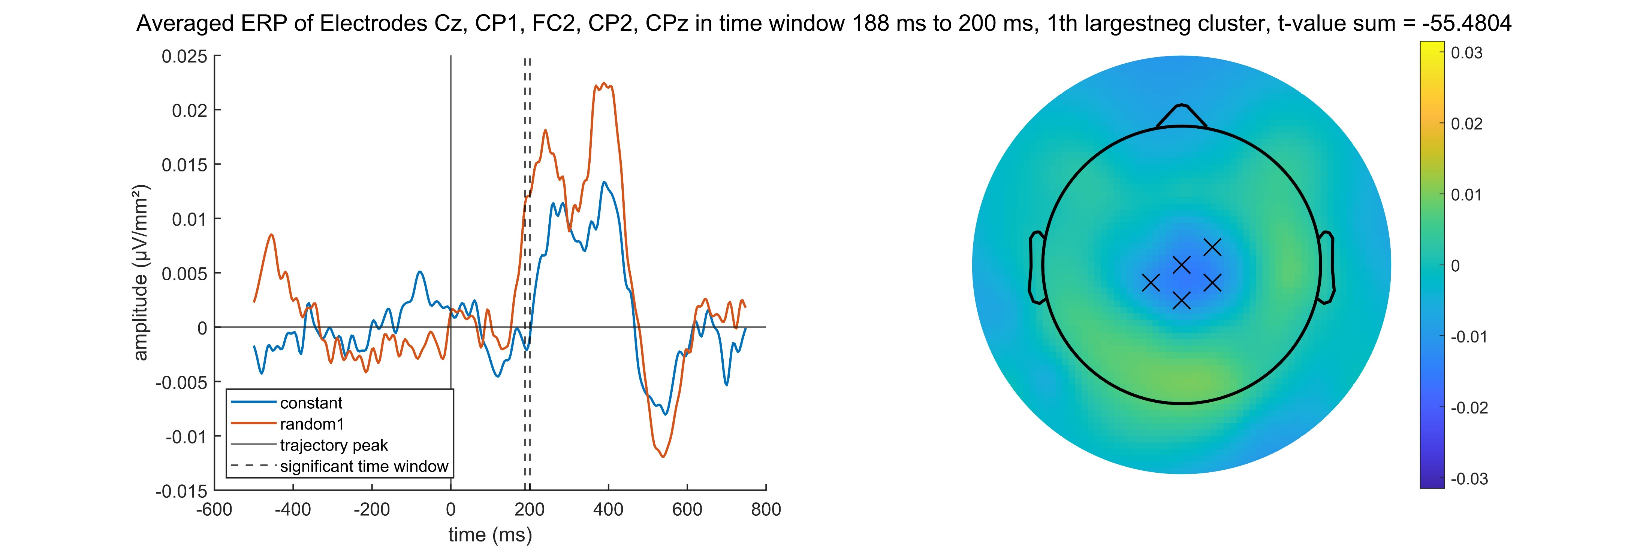
Constant – Random1 negative

Slide 4
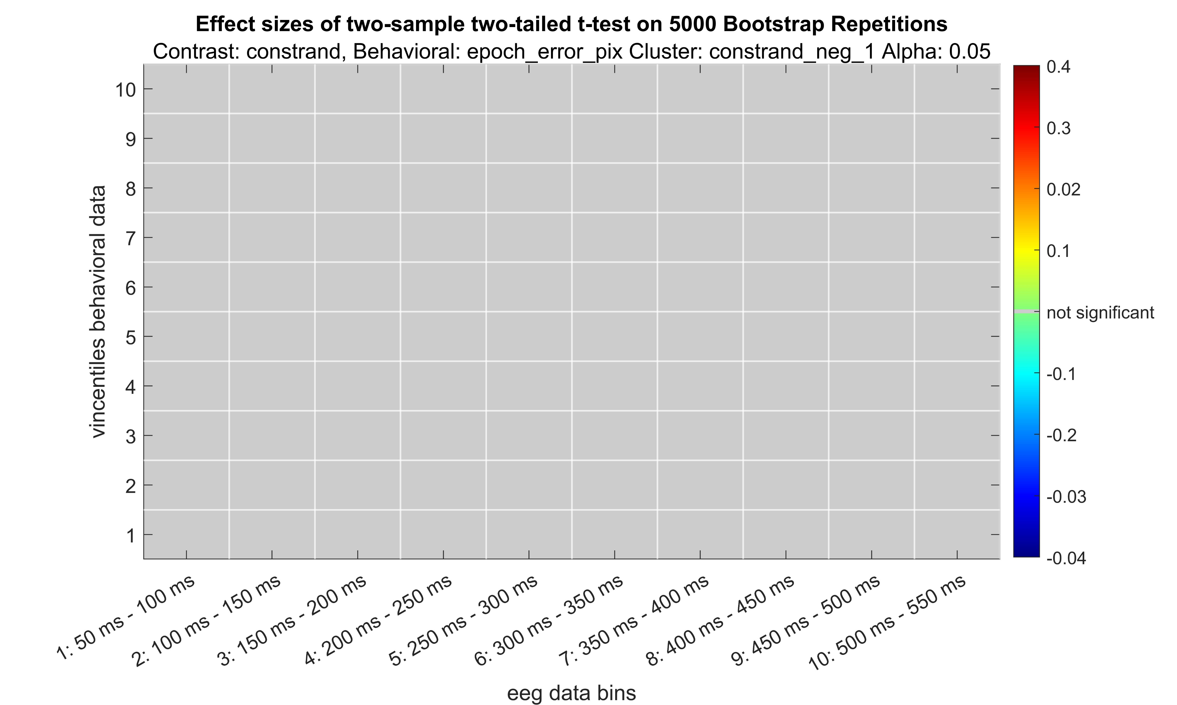
Constant – Random1 negative
Not actually robust, just normal cohen‘s d
This is what a plot without significant tests looks like now

Slide 5
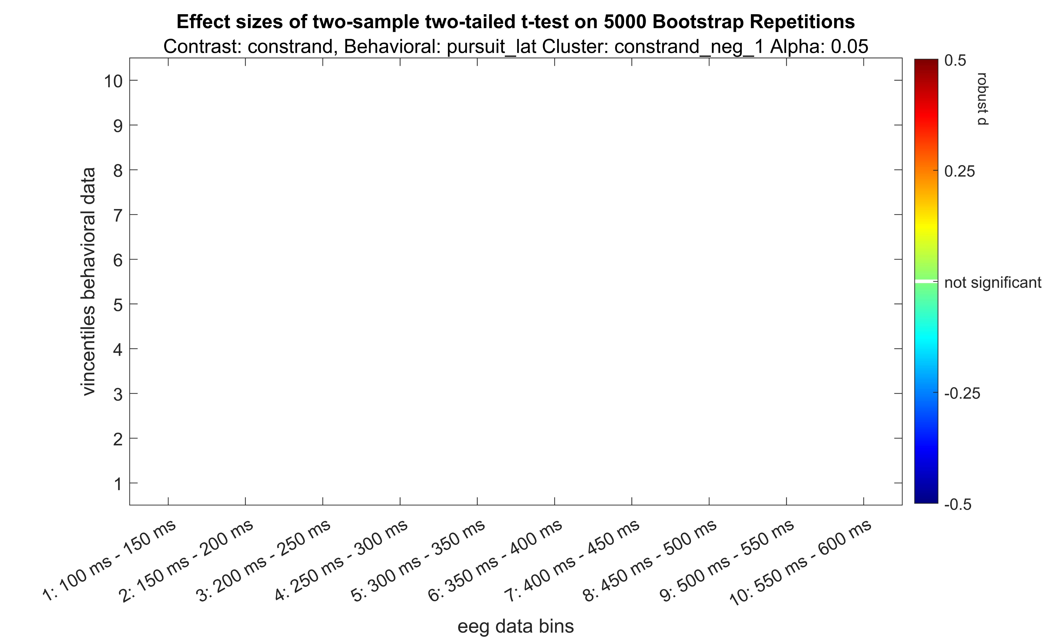
Constant – Random1 negative

Slide 6
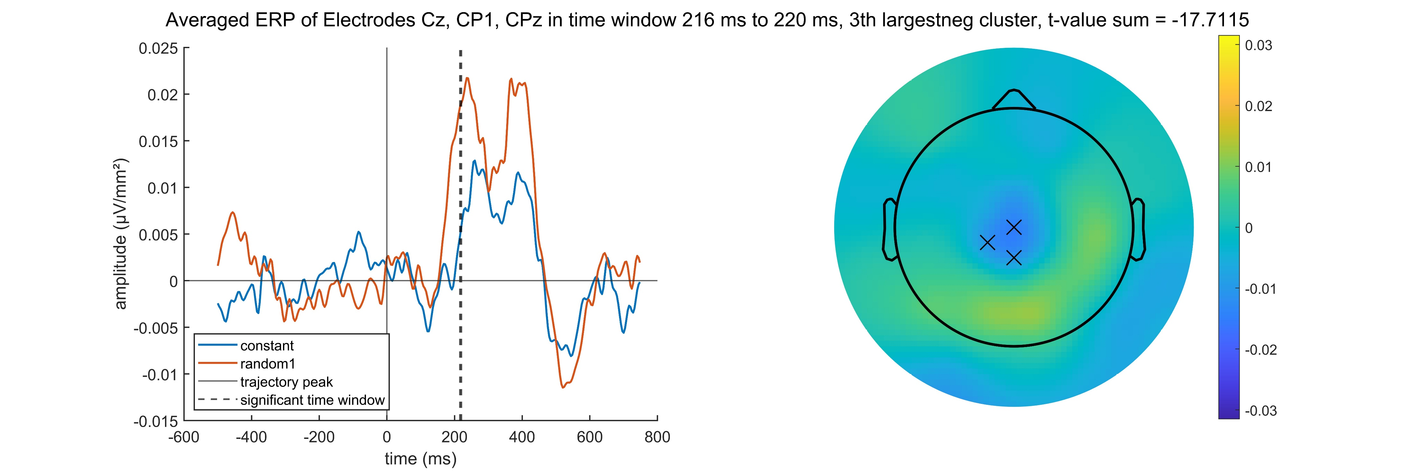
Constant – Random1 negative

Slide 7

Constant – Random1 negative

Slide 8

Constant – Random1 negative

Slide 9
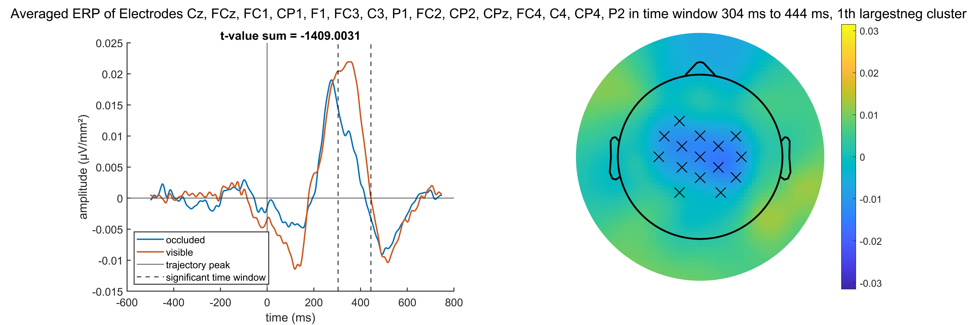
Occluded – Visible negative

Slide 10
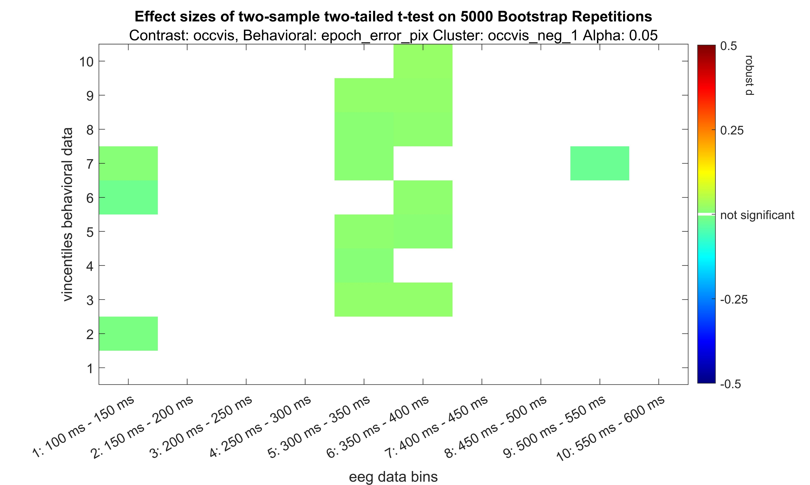
Occluded – Visible negative

Slide 11
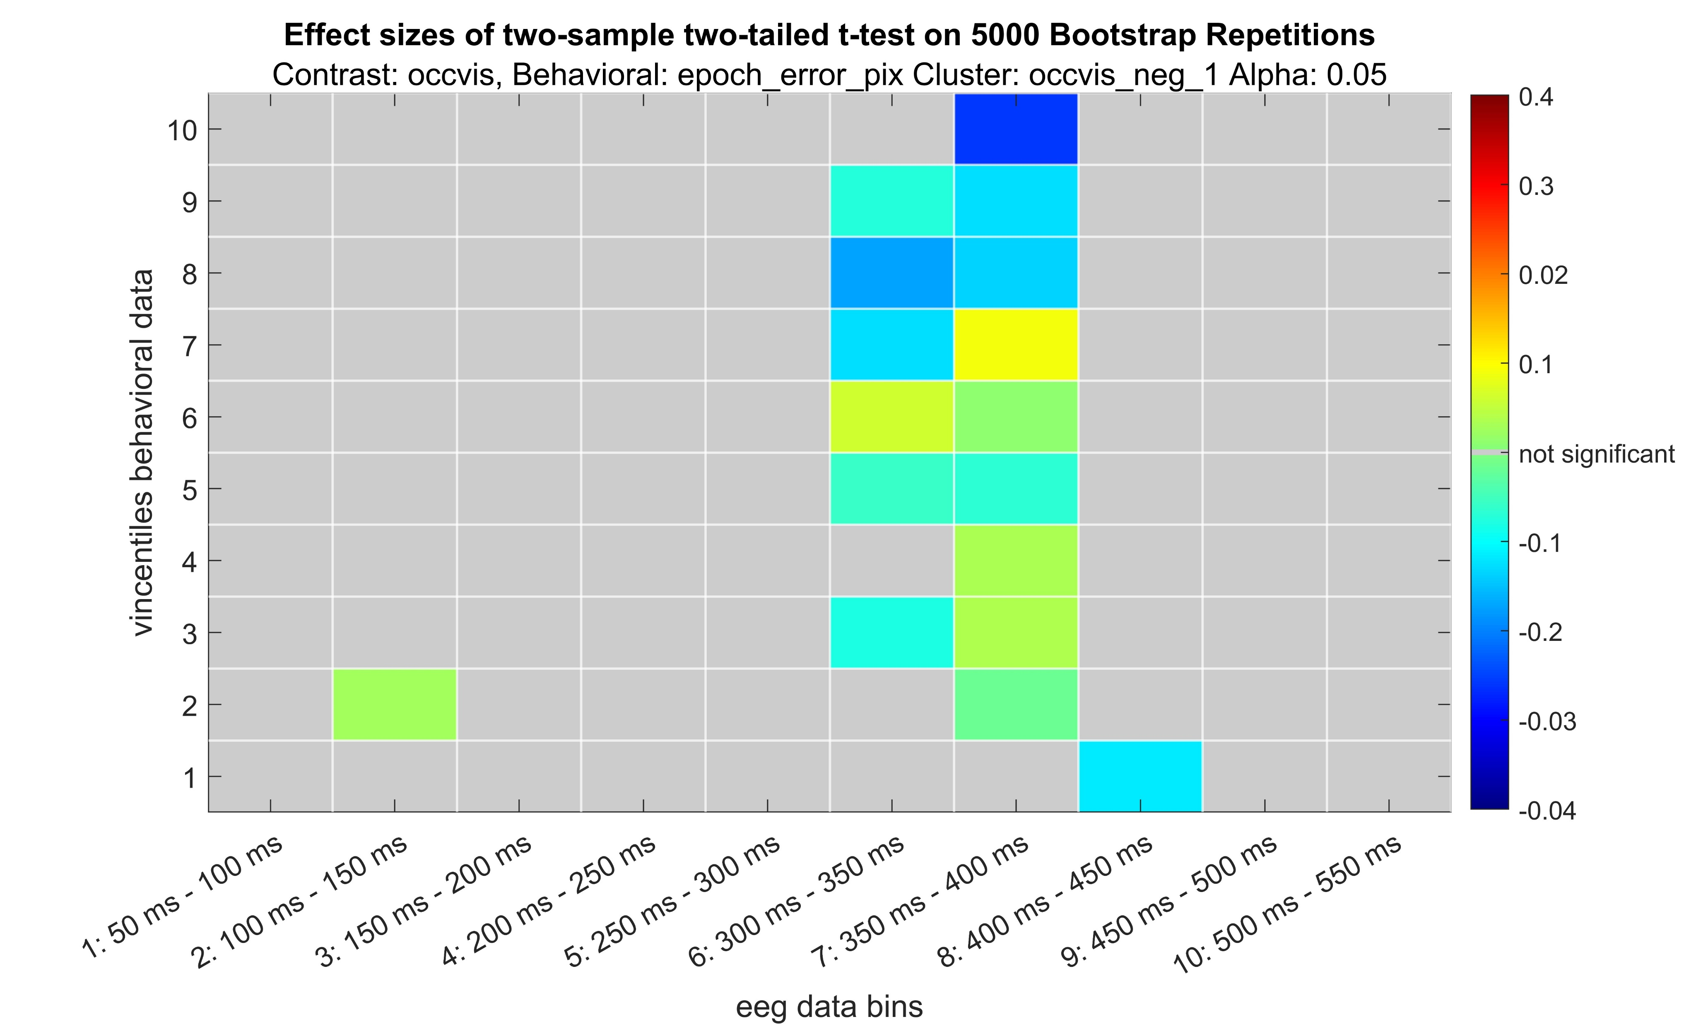
Occluded – Visible negative

Slide 12
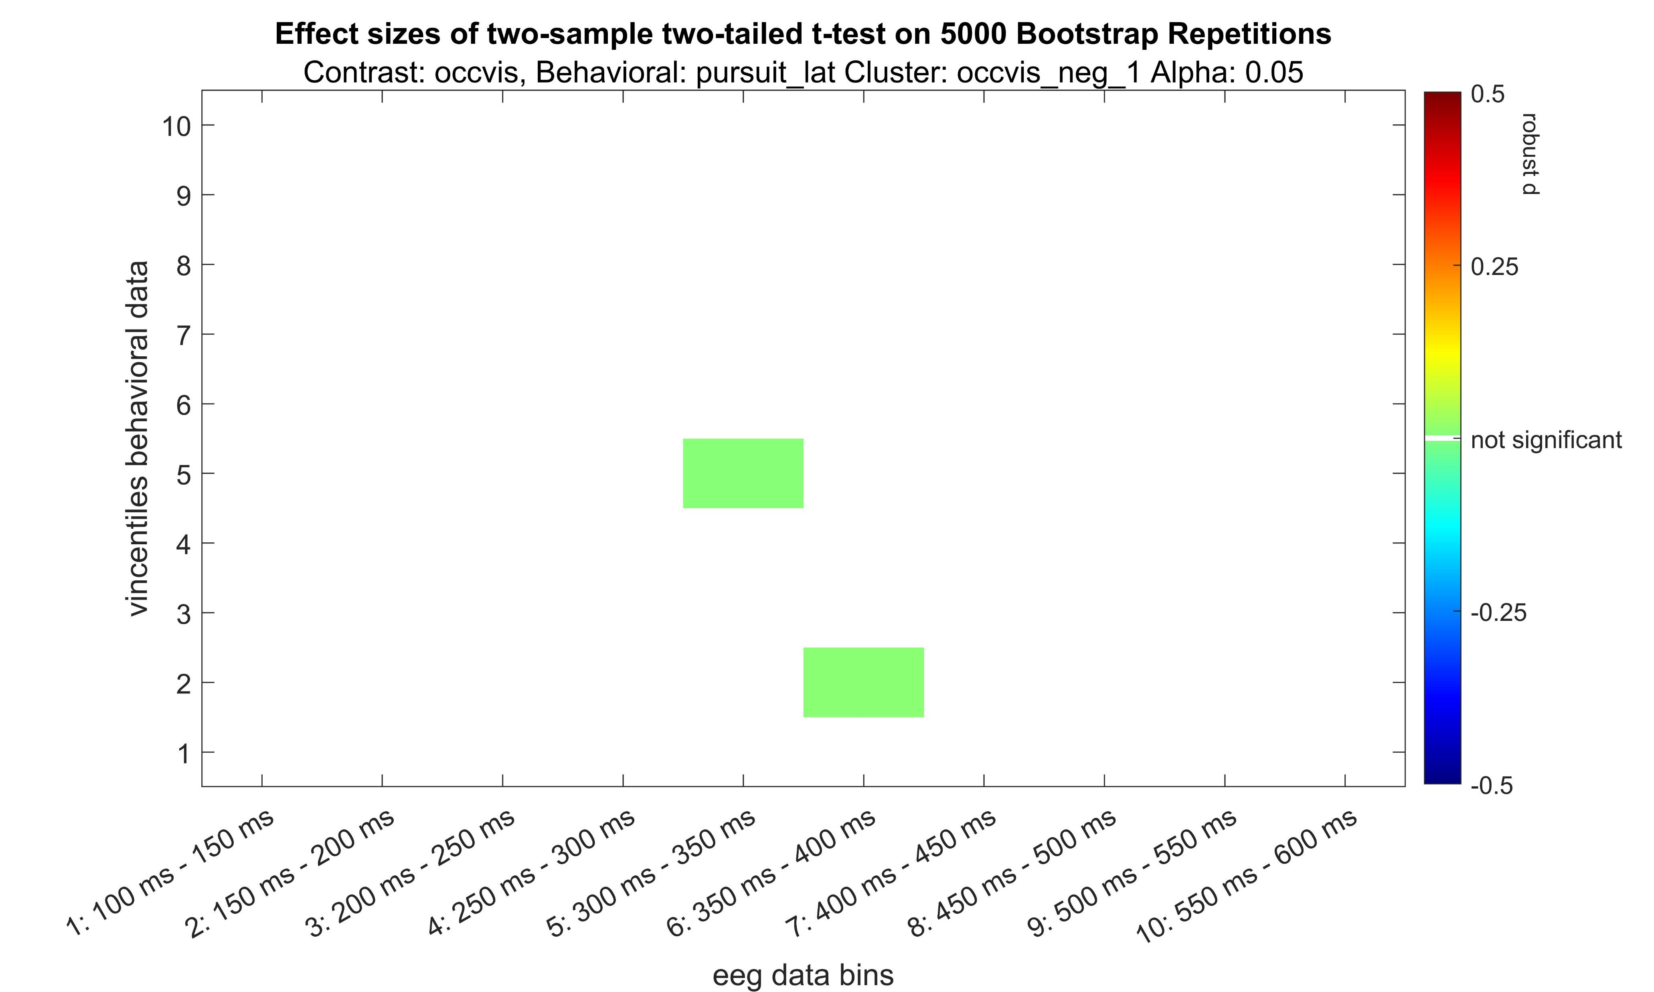
Occluded – Visible negative

Slide 13
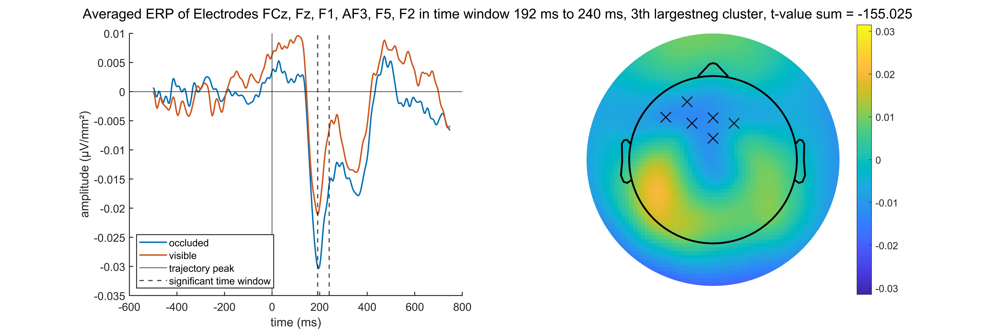
Occluded – Visible negative

Slide 14
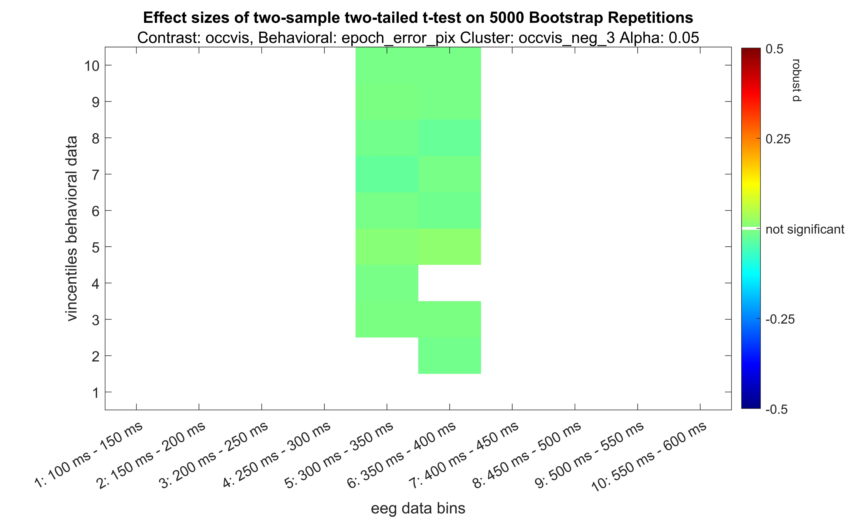
Occluded – Visible negative

Slide 15
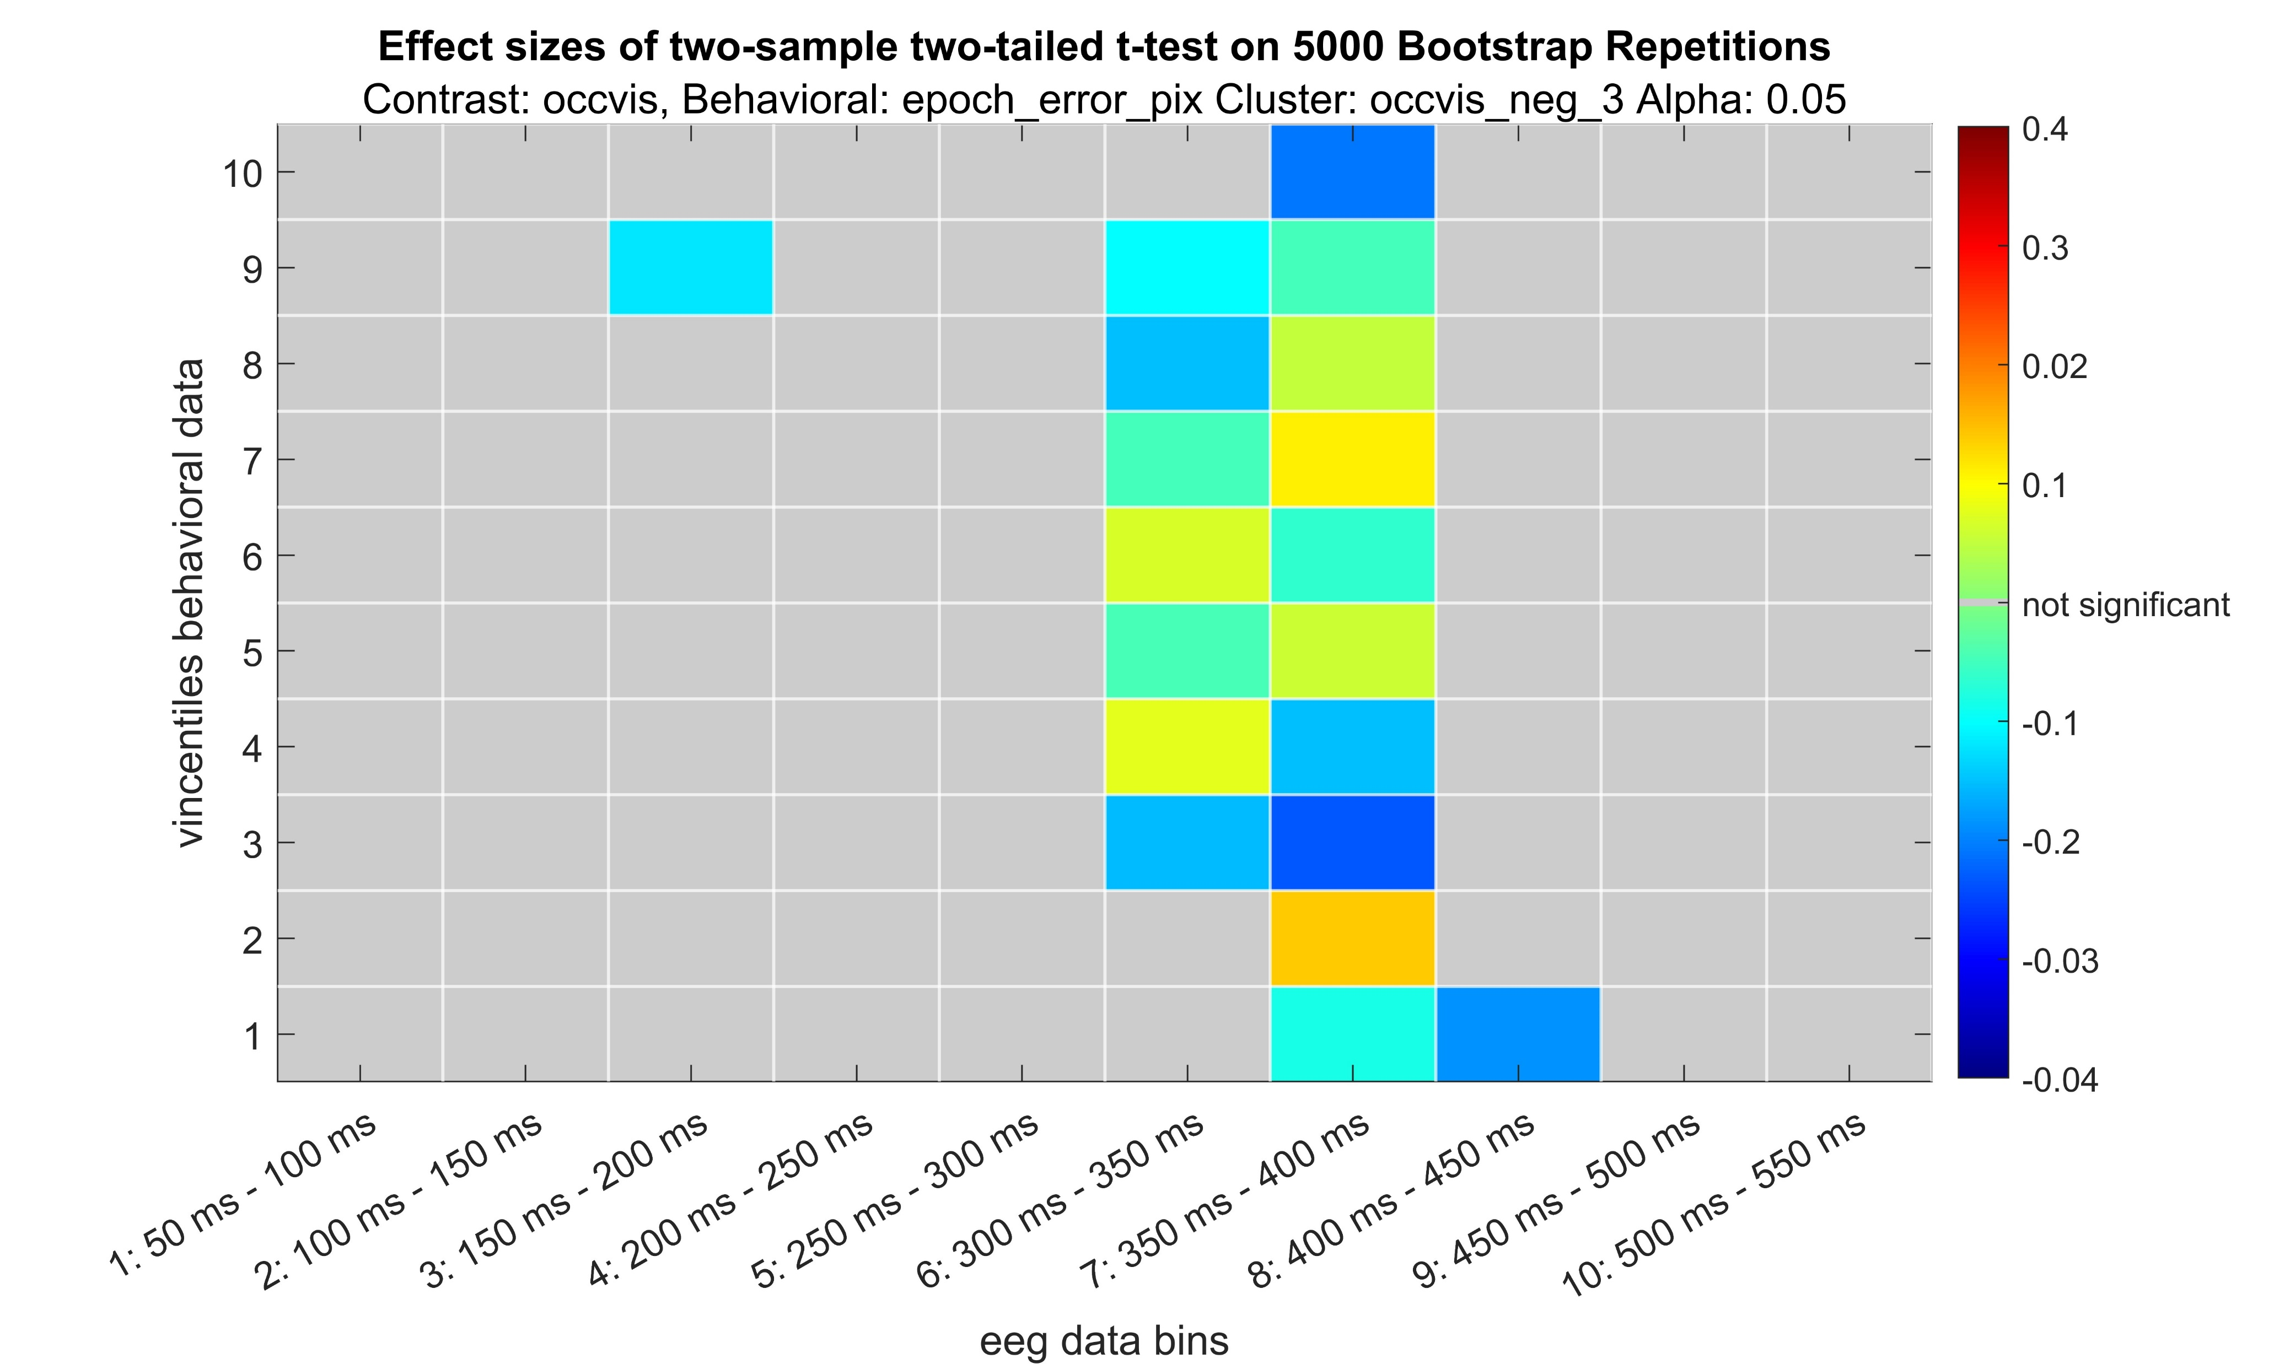
Occluded – Visible negative

Slide 16
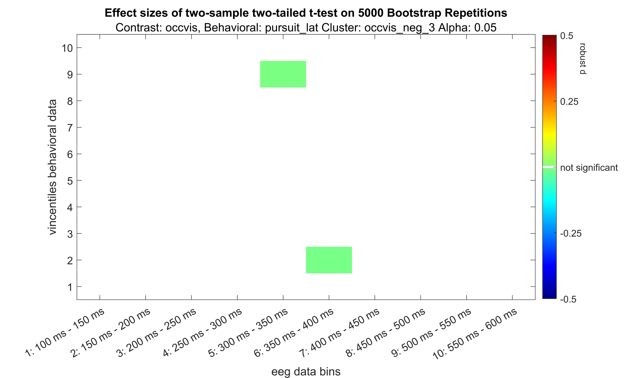
Occluded – Visible negative

Slide 17
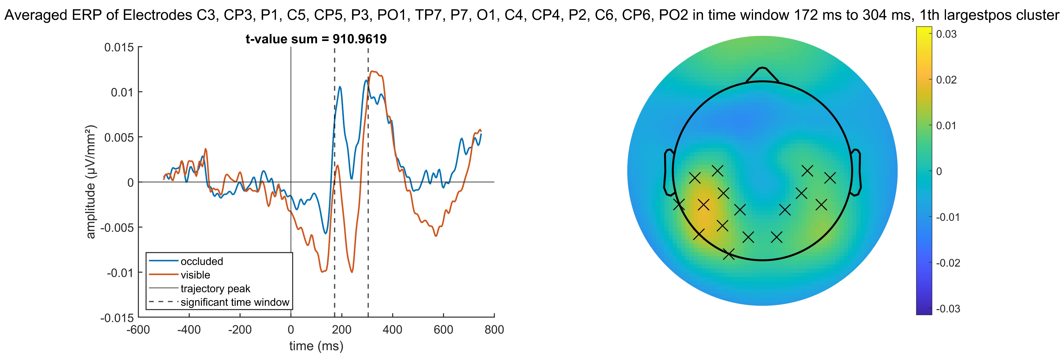
Occluded – Visible positive

Slide 18
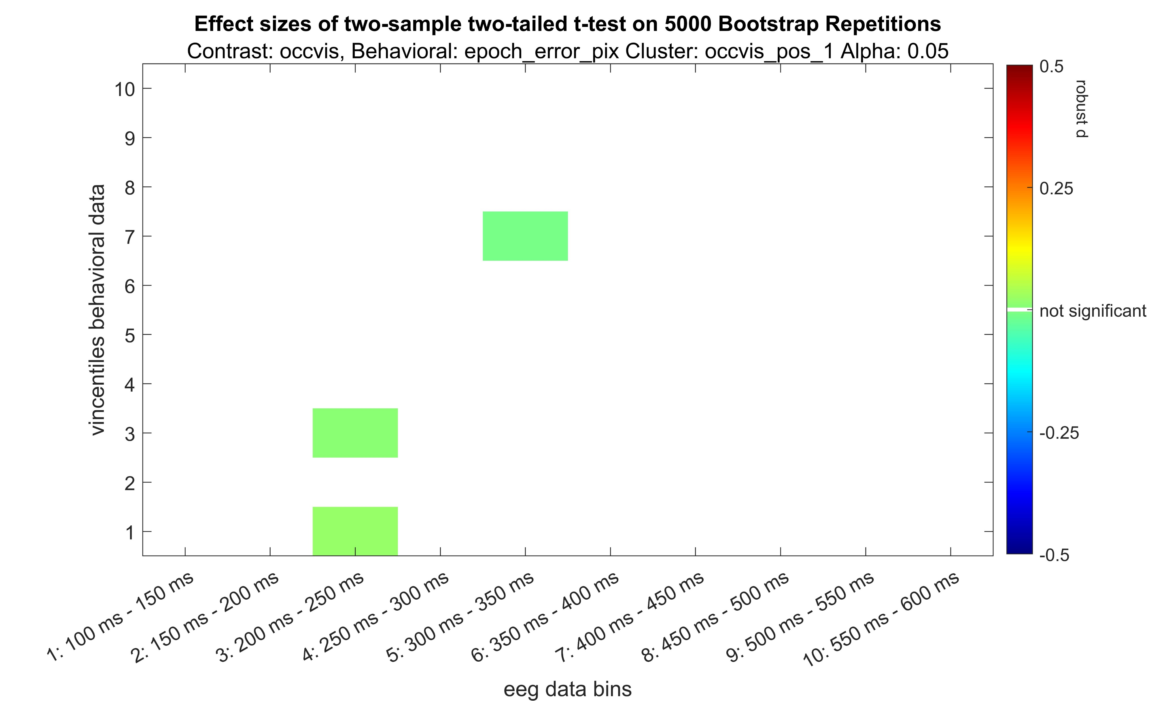
Occluded – Visible positive

Slide 19
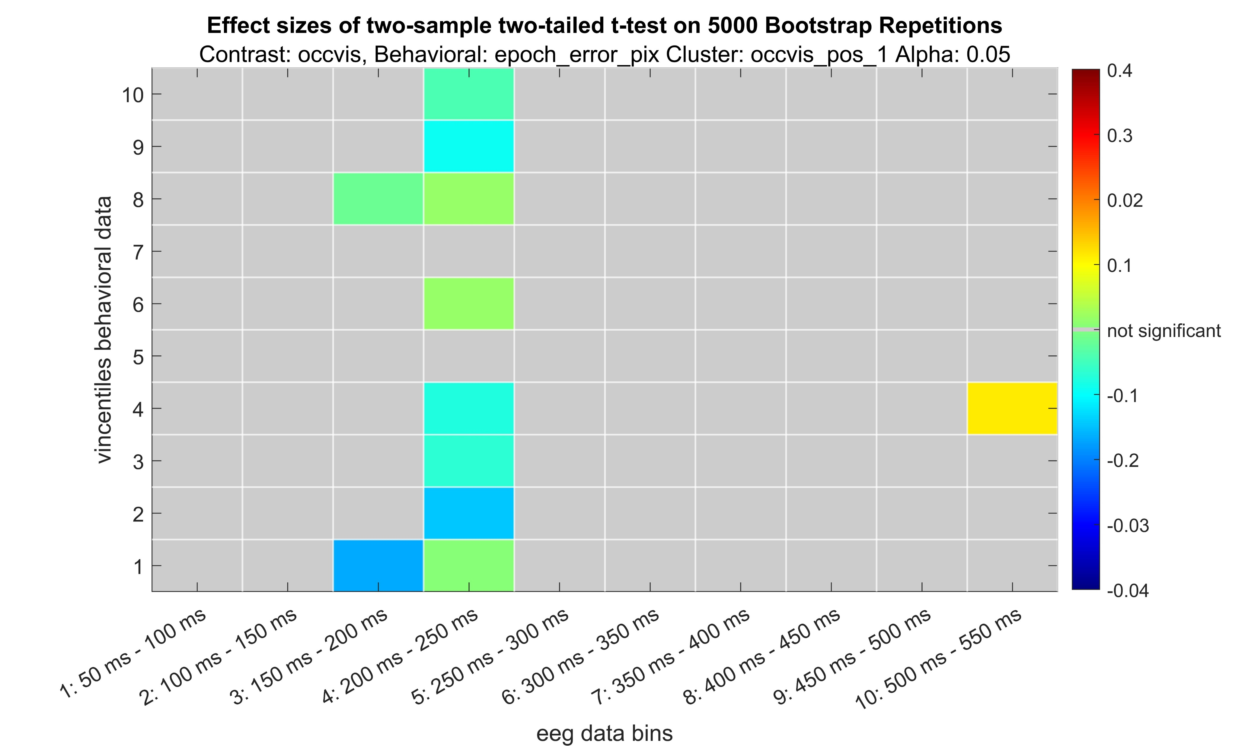
Occluded – Visible positive

Slide 20
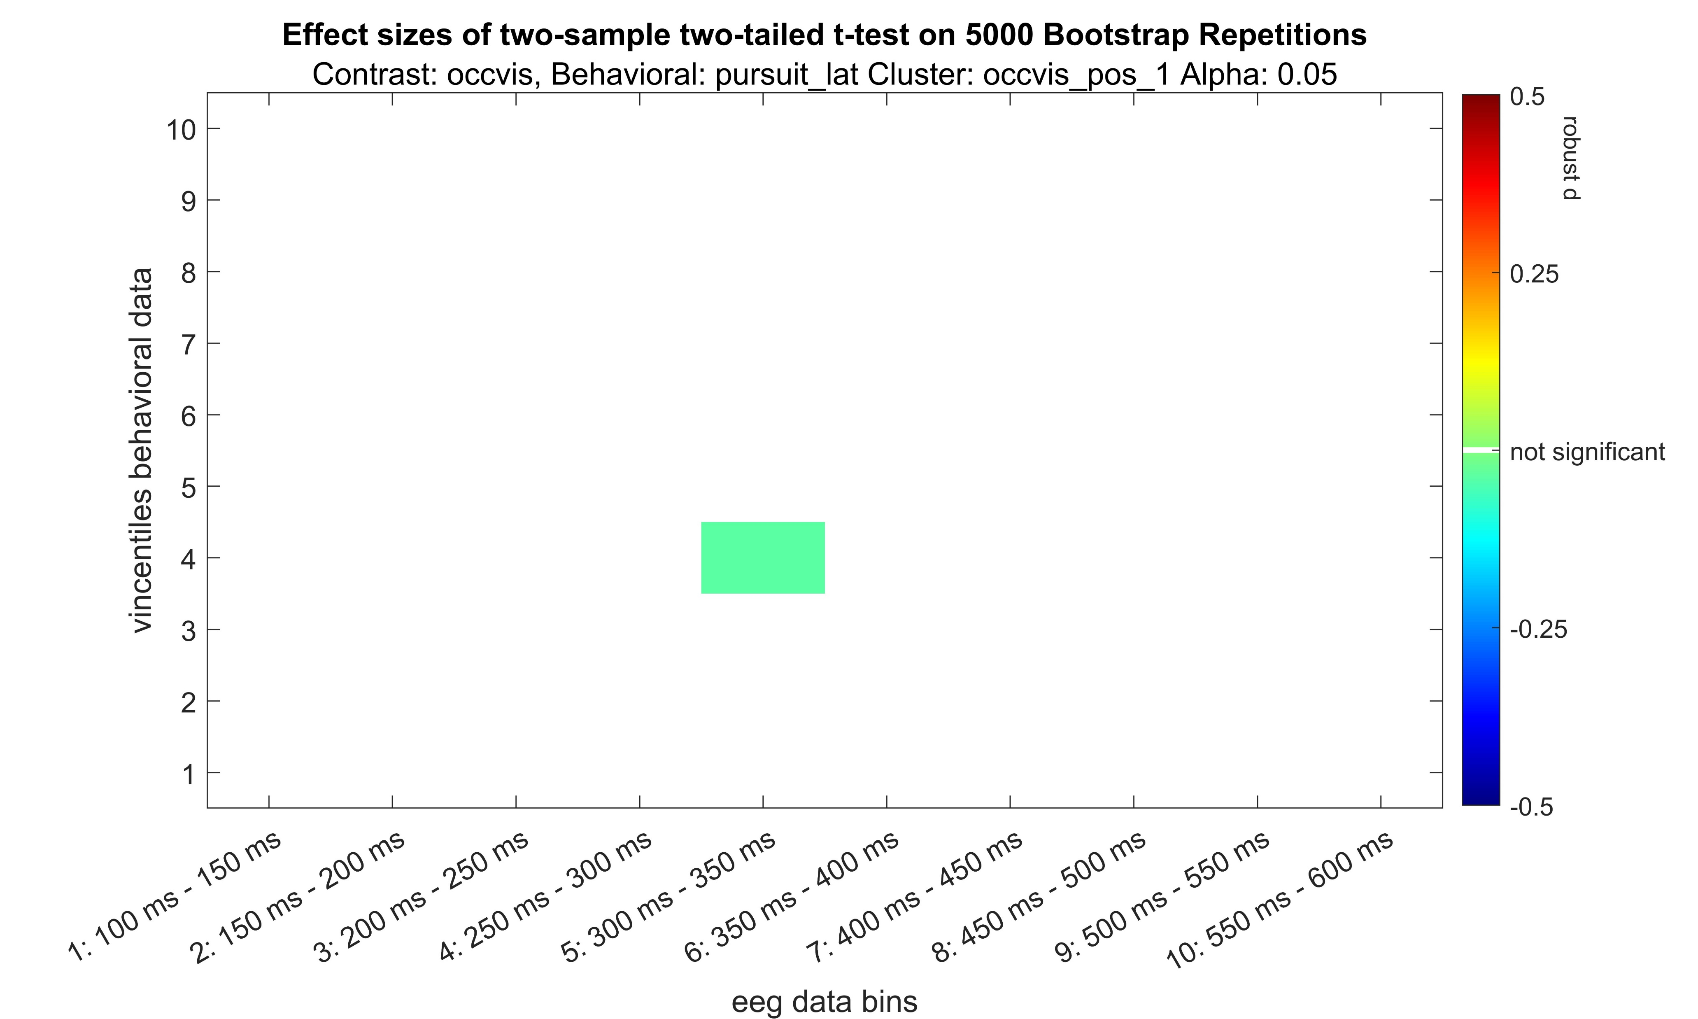
Occluded – Visible positive

Slide 21
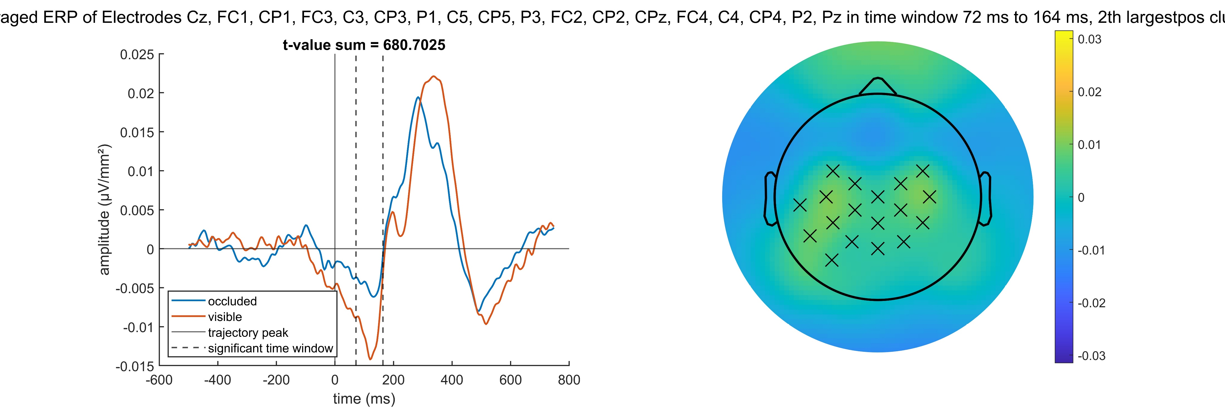
Occluded – Visible positive

Slide 22
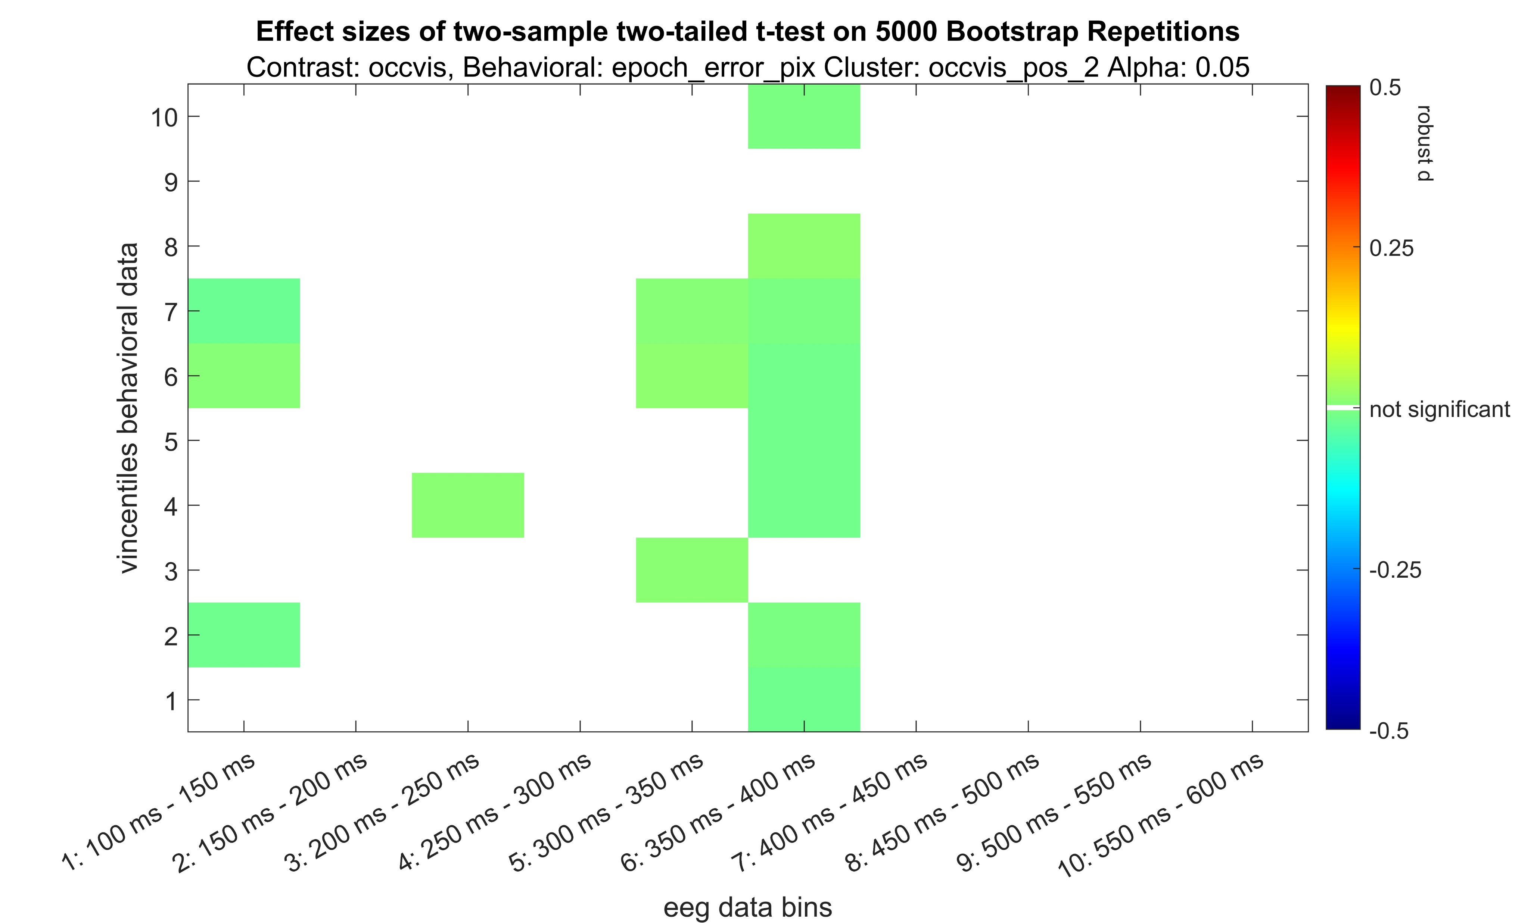
Occluded – Visible positive

Slide 23
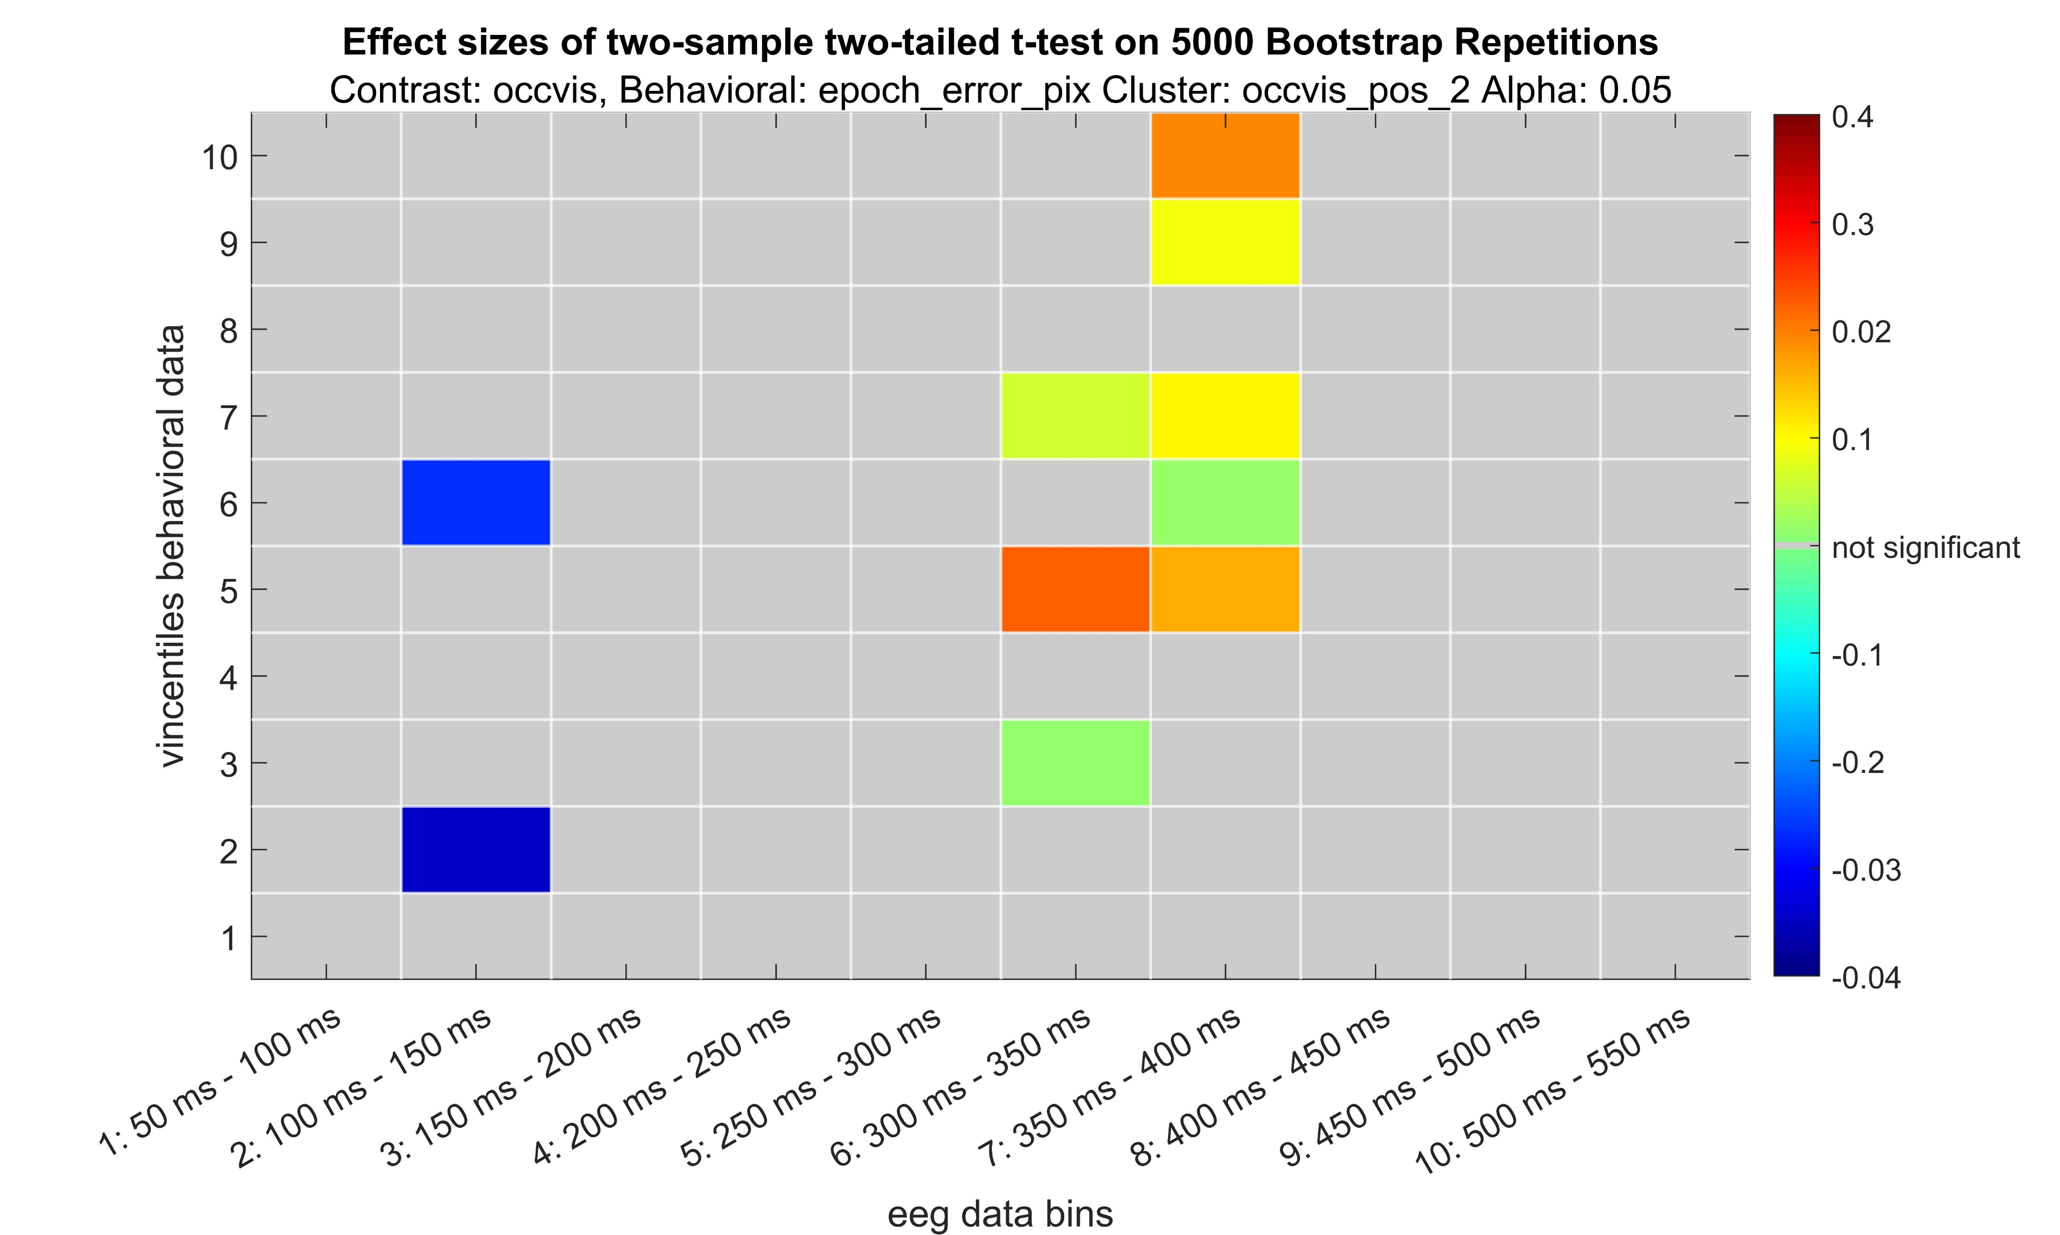
Occluded – Visible positive

Slide 24
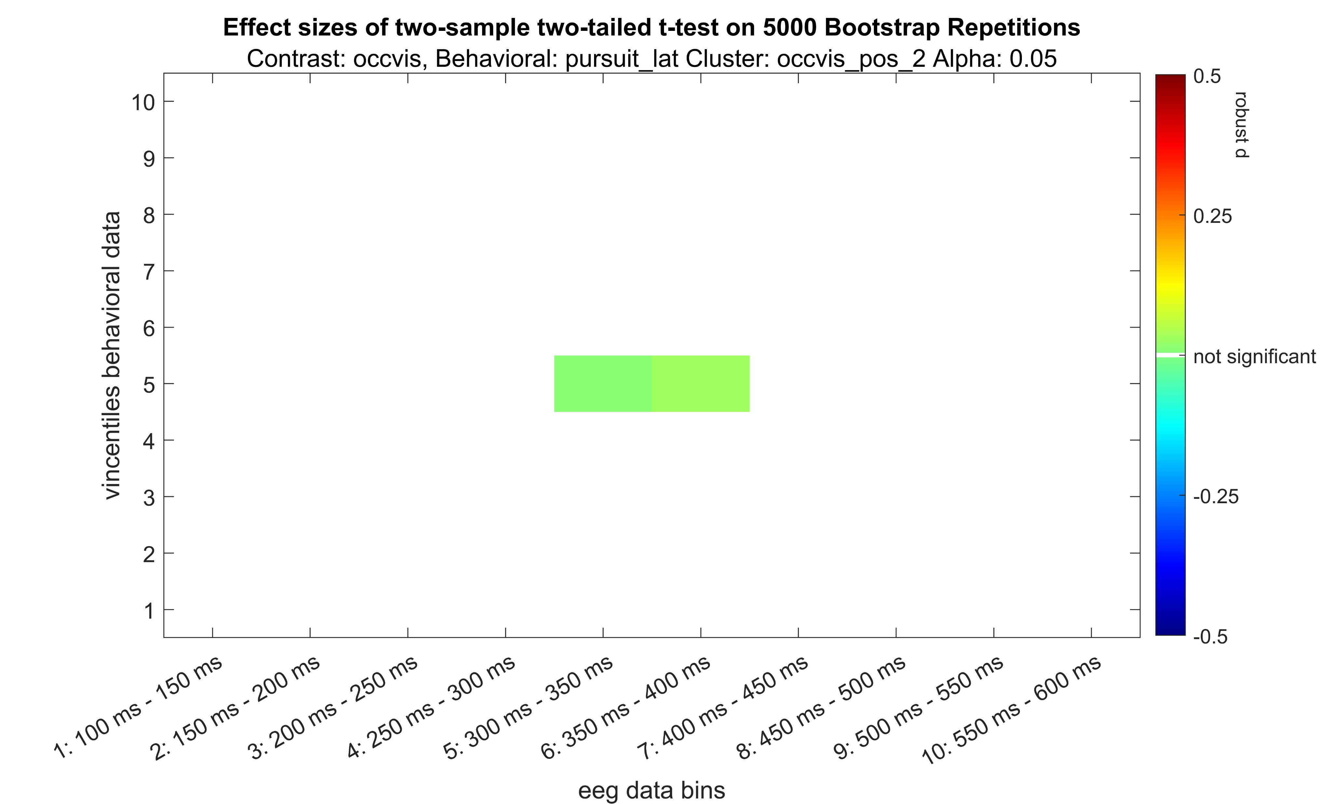
Occluded – Visible positive

Slide 25
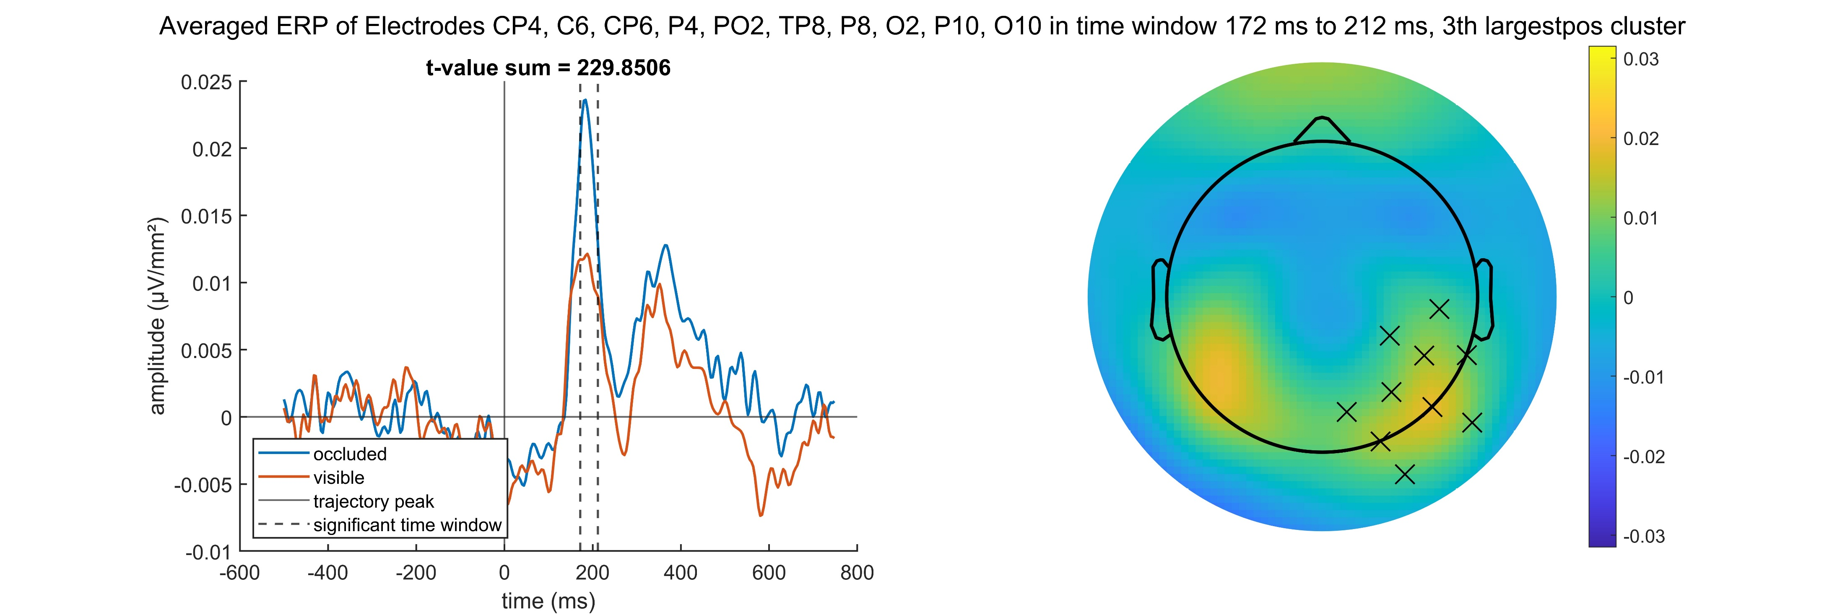
Occluded – Visible positive

Slide 26
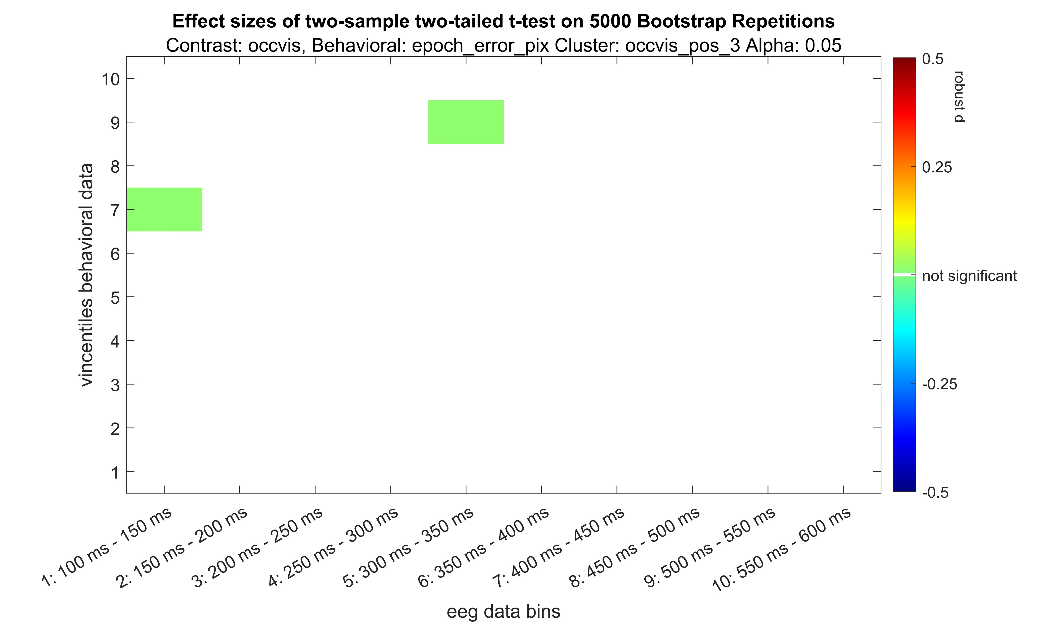
Occluded – Visible positive

Slide 27
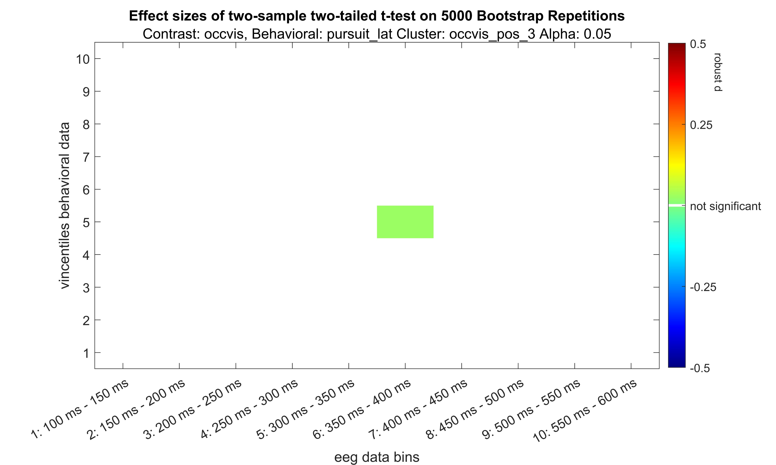
Occluded – Visible positive

Slide 28
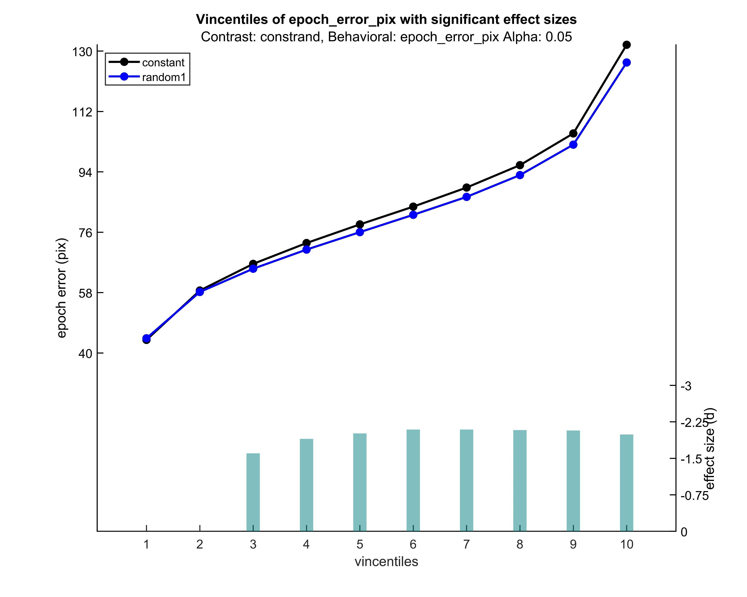
Concept of how I‘d implement the plotting ideas for the behavioral data

Slide 29
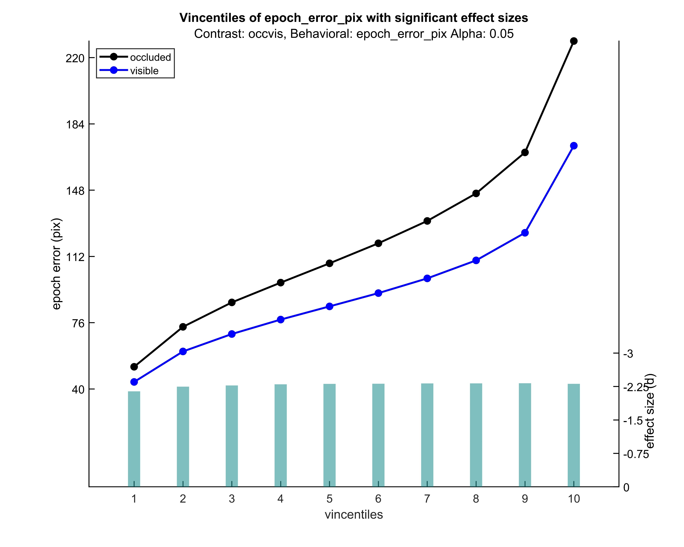

Slide 30
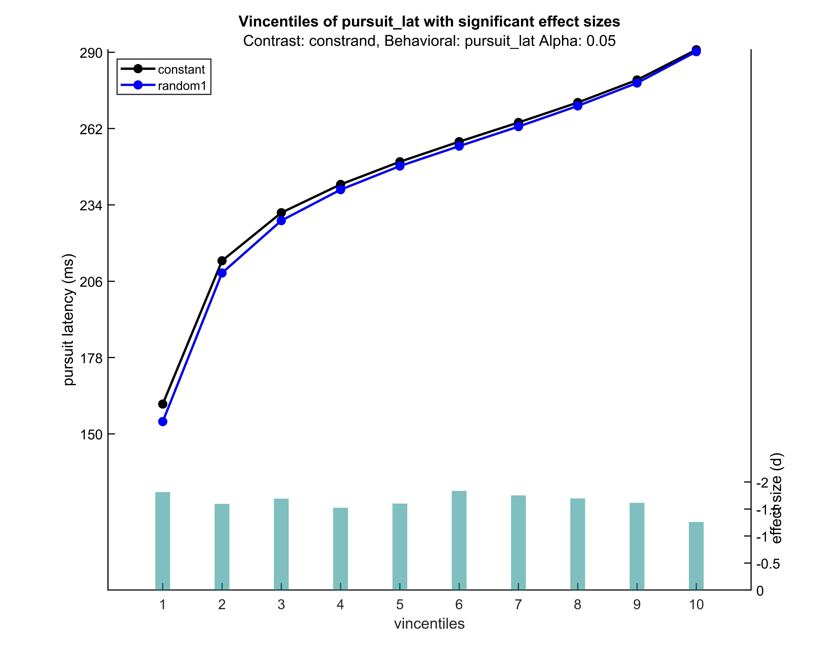

Slide 31
